Slide 1
PLACEMENT RECRUITMENT SYSTEM
NIKHIL RANGA (160118737031)
PRANEETH KUMAR KADAMPALLY (160118737034)
Guided by:
Dr Srinivas Andoju.

Slide 2
Contents
Introduction
Existing system
Proposed system
Software and Hardware Requirements
Implementation
Testing and Results
Conclusions

Slide 3
Introduction
The Placement Recruitment System is developed as an attempt to take a record of company and students by restricting database to that of a particular class of students or company. The system provides the facility of viewing both the personal and academic information of the student and company. It can also search for eligible students. This software is easily accessible and saves time. We developed this software using C++ programming language. Eligible students are recruited based on their performance.

Slide 4
Existing System
The existing system describes the features of the previous working model and their drawback.
This is tedious and time consuming, lack of security of data, took more man power, consumes large volume of paper and space.
This process is so difficult when number of user’s increases.

Slide 5
Proposed System
The proposed system can overcome all the limitation of the existing system, such as
Student’s information is maintained in the database.
It gives more security to data and ensures data accuracy.
Reduces paper work and save time.
It makes information flow efficient and paves way for easy report generation.

Slide 6
Software Requirements
Operating System : Windows*7 or later ,macOS, and Linux.
Included development tools : Dev C++
Notepad

Slide 7
Hardware Requirements
Processors: Intel Atom® processor or Intel® Core™ i3 processor.
Disk space: 1 GB.
Input device (mouse / trackpad) to select options
32 – 64 bit processor
Sufficient RAM to run the program (Minimum 2GB)

Slide 8
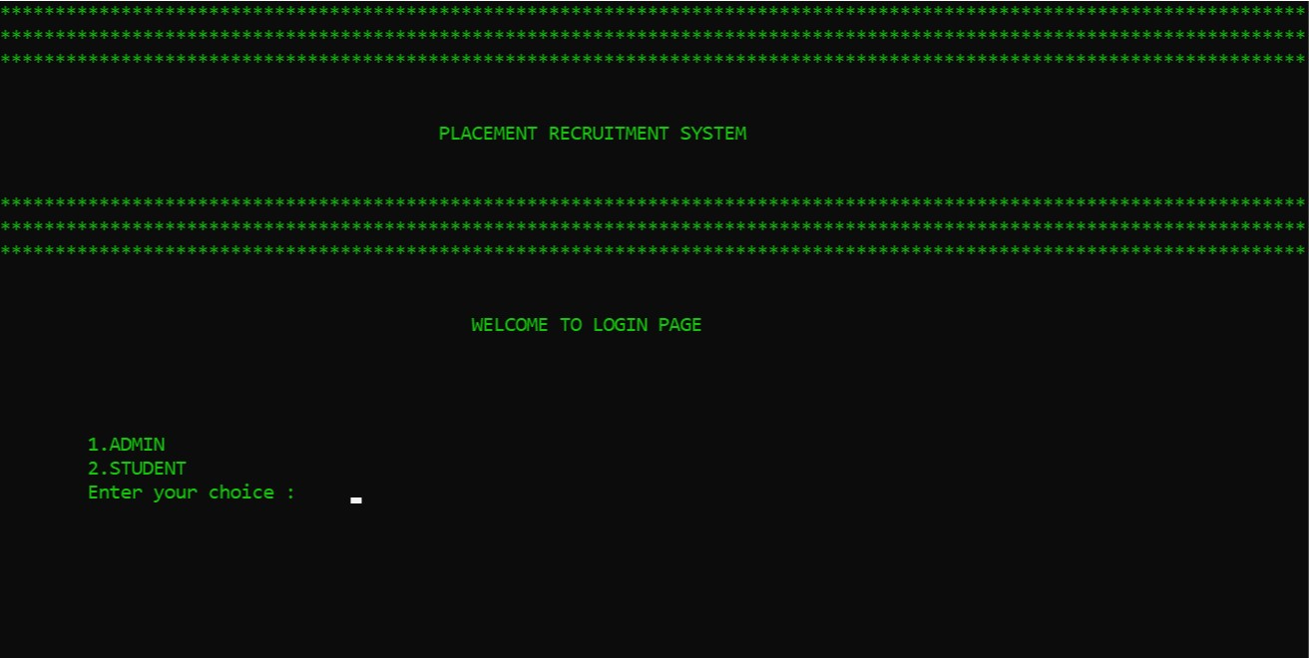
Implementation
Main page

Slide 9
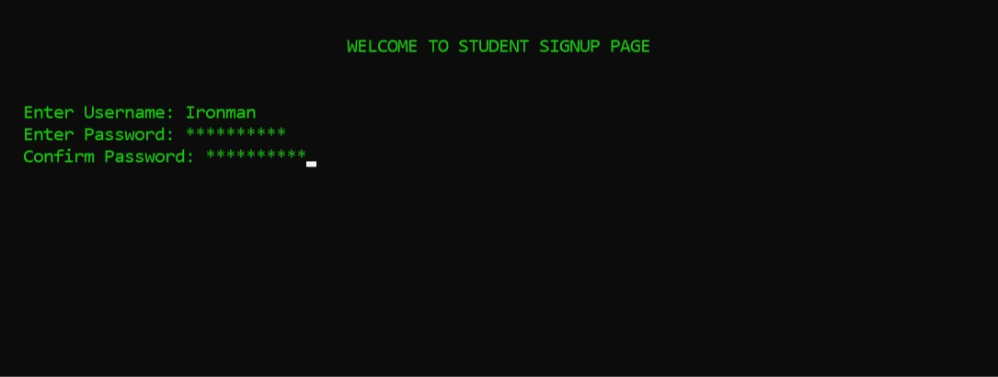
Implementation (cont.)
Student signup page 1

Slide 10
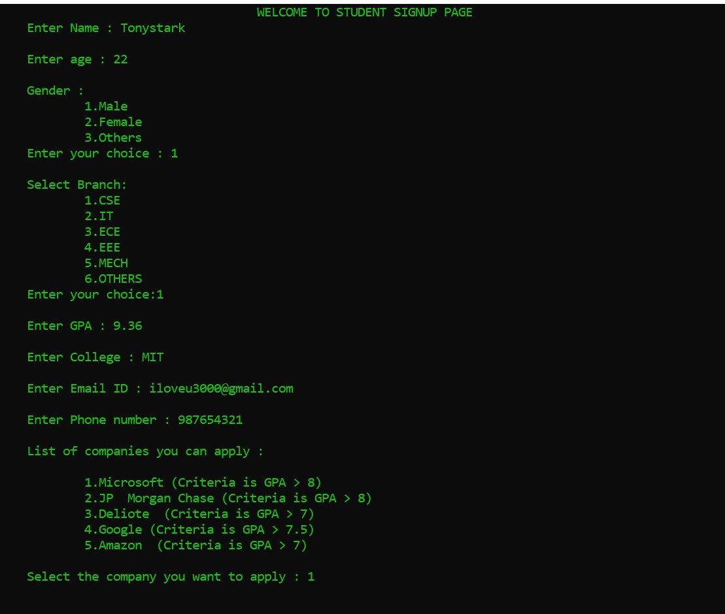
Implementation (cont.)
Student details

Slide 11
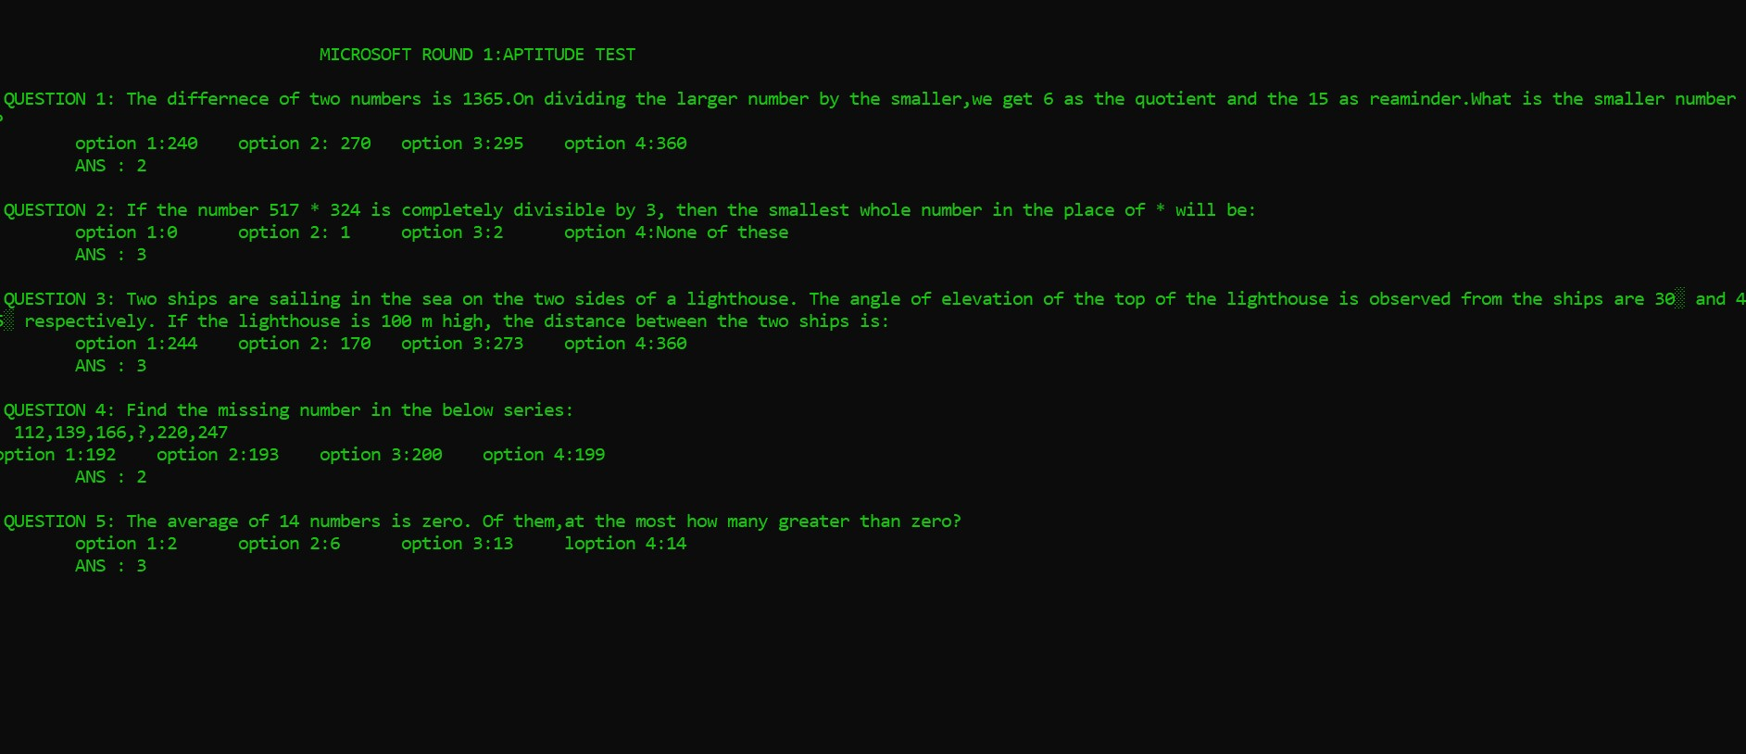
Implementation (cont.)
Aptitude round

Slide 12
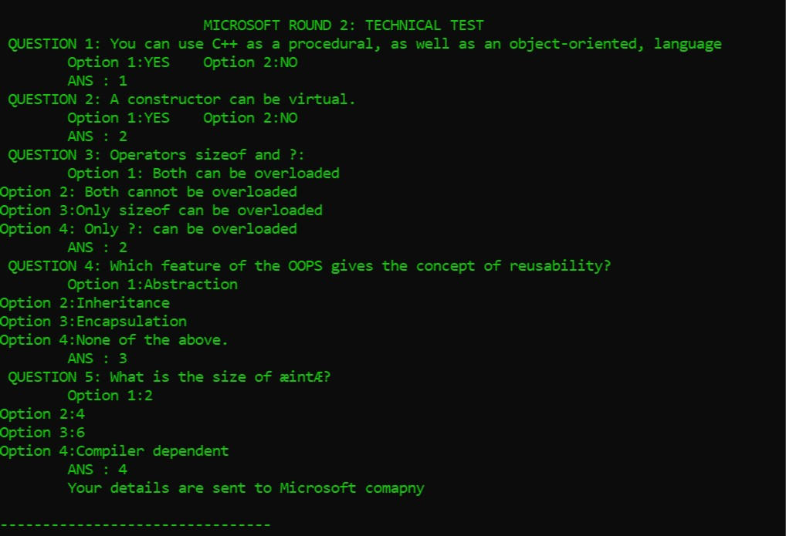
Implementation (cont.)
Technical round

Slide 13
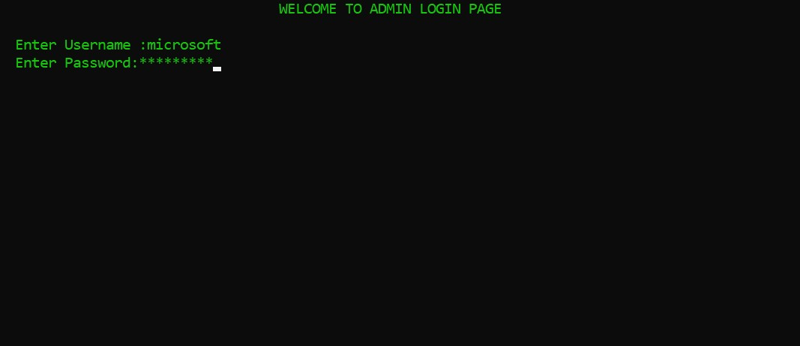
Implementation (cont.)
Admin login page

Slide 14
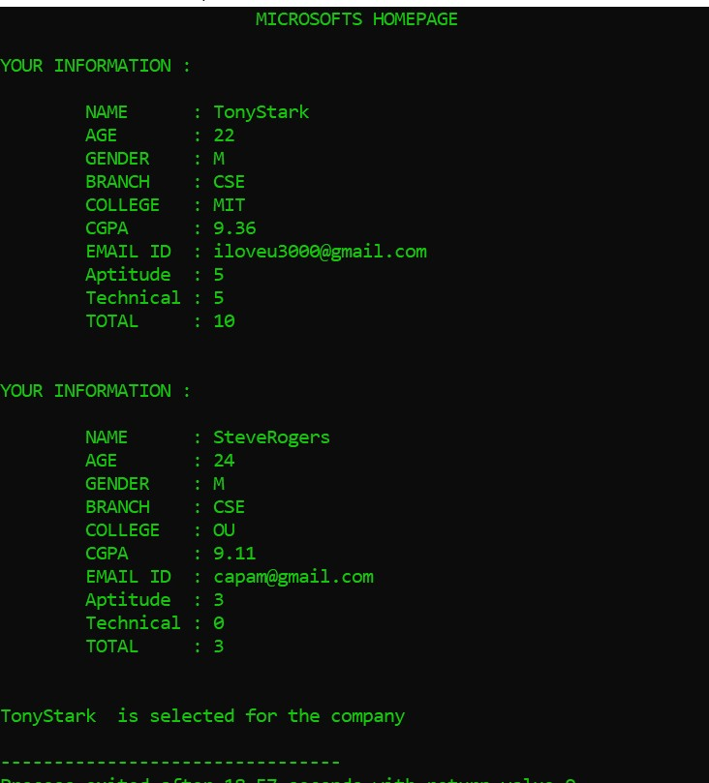
Implementation (cont.)
Displaying student details

Slide 15
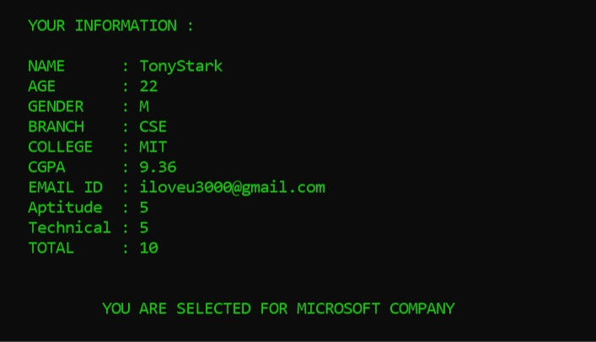
Implementation (cont.)
Student login page

Slide 16
CONCLUSION
Placement Recruitment System can be easily plugged in many other systems. This system overcomes the problem of managing the student information manually.

